Slide 1
Program Relocation

Slide 2
Program relocation means loading the object program to available memory location as the specified memory location is occupied by other program or data
Relocating the object program from the specified starting address in program to available address know at load time

Slide 3
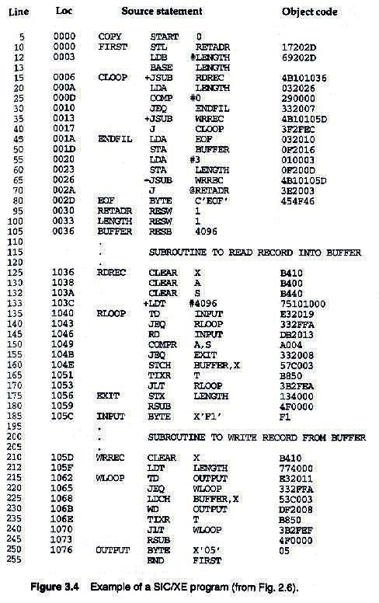

Slide 4
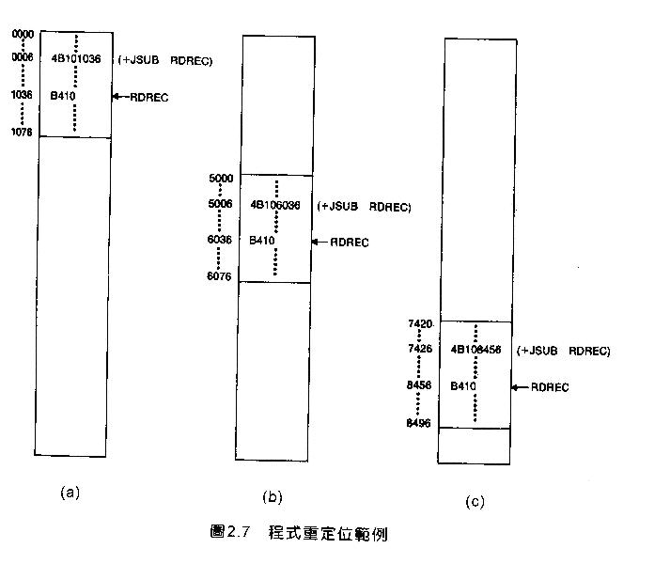
Example of program relocation

Slide 5
Example
Absolute program, starting address 0000
e.g. 15 0006 CLOOP +JSUB RDREC 4B101036
Relocate the program to 1000
e.g. 15 0006 CLOOP +JSUB RDREC 4B102036
Each Absolute address should be modified
Except for absolute address, the rest of the instructions need not be modified
not a memory address (immediate addressing)
PC-relative, Base-relative
e.g. 10 0000 FIRST STL RETADR 17202D
The only parts of the program that require modification at load time are those that specify direct addresses

Slide 6
How program relocation done?
Assembler does not know the actual location where program will be loaded
It cannot make the necessary changes in the address used by the program
But assembler can identify for the loader those part of the object program that need modification using MODIFICATION RECORD
An object program that contains the information necessary to perform this kind of modification is called relocatable program

Slide 7
MODIFICATION RECORD
Modification record
col 1: M
col 2-7:Starting location of the address field to be modified
col 8-9: length (halfbyte)
col 10: flag (+/-)
col 11-17: segment name

Slide 8
Example
4 B
1 0
1 0
3 6
0006
0007
Red digit indicate 5 half byte is to be modified
0008
0009
Modification record of JSUBM(Line 15): M^000007^05

Slide 9
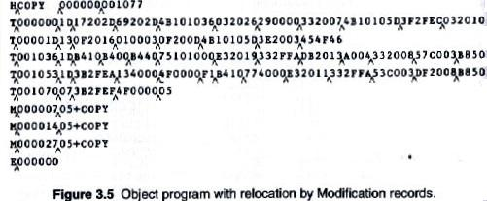

Slide 10
Each Modification record specifies the starting address and length of the field whose value is to be altered.
It then describes the modification to be performed.
In this example, all modifications add the value of the symbol COPY, which represents the starting address of the program.

Slide 11
Linking External symbols

Slide 12
Explain define and refer record (Refer Assembler ppt)
Explain ESTAB
Explain how linking loader perform linking using ESTAB(Algorithm of linking loader)

